Slide 1

MANAGING AGILE ENVIRONMENT

Slide 2


Slide 3
How are agile projects managed?
Within agile development, Scrum has the most to say about exactly what is agile project management.
Agile project management divides responsibility among more than one team member
Using Scrum model there are three roles: product owner, ScrumMaster and team.

Slide 4
SCRUM MASTER
The Scrum Master serves as the team's coach,
helping team members work together in the most effective manner possible.
views the role as one of providing a service to the team
removing impediments to progress
facilitating meetings and discussions
performing typical project management duties such as tracking progress and issues.

Slide 5
THE TEAM
The team itself assumes agile project management roles
when determining how to best achieve the product goals (as established by the product owner).
Team members will collaboratively decide which person should work on which tasks,
which technical practices are necessary to achieve stated quality goals, and so on.

Slide 6
An effective Project Manager is required to be knowledgeable about Project Management.
Apply this project management knowledge in order to drive team performance.
Have positive personal attitude as it will be spread out to the project team

Slide 7
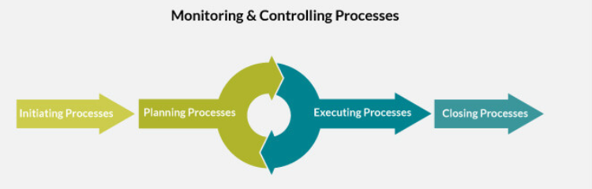

Slide 8
Who handles conventional project manager duties in agile development?
Agile project management often puts the traditional project manager in a difficult position.
He or she is told, for example, to make scope/schedule tradeoff decisions knowing that a product manager or customer might second-guess those decisions if the project goes poorly.

Slide 9
The Agile Project Manager (APM) is responsible for planning, leading, organizing, and motivating Agile project teams.
Achieve a high level of performance and quality, and
Deliver agile projects that provide exceptional business value to users
The APM may be responsible for managing several concurrent high visibility projects using agile methods in a fast-paced environment that may cross multiple business divisions.

Slide 10
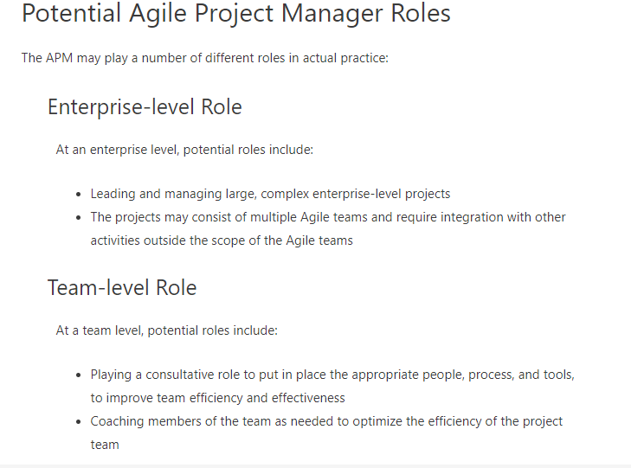

Slide 11
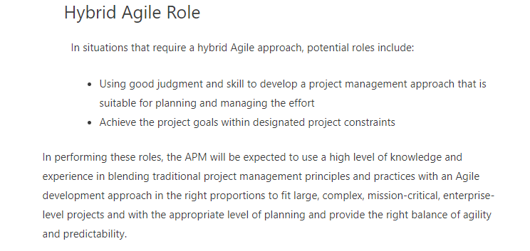

Slide 12
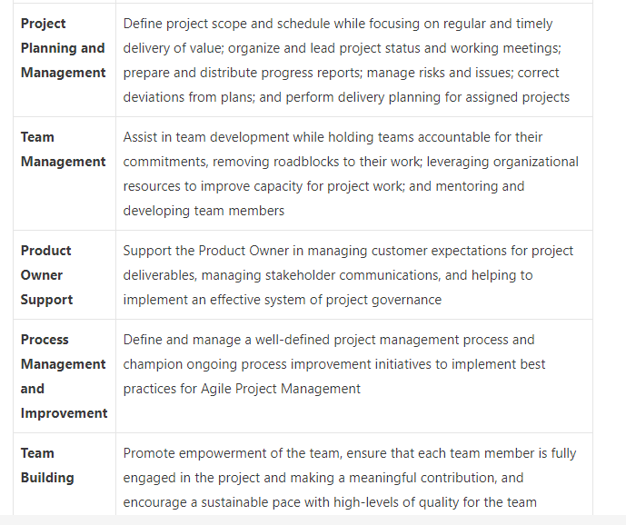
Agile Project Management Job Description

Slide 13
ATTEMPT THE QUIZZ IN THE LINK BASED ON THIS SESSION.

